Slide 1
Solar Tank Storage vs Batteries
Notes:
This module provides an understanding of how to select and configure a system for specific customer needs using the LORENTZ COMPASS software.
Introduction to COMPASS
Helping yourself
Key terms
COMPASS training
Screen layout and overview
Quick sizing
Pump datasheets and information
Saving projects and providing pdf outputs

Slide 2
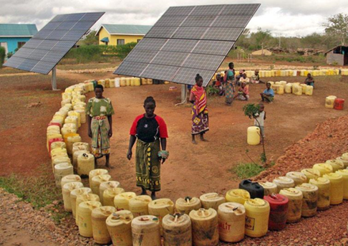
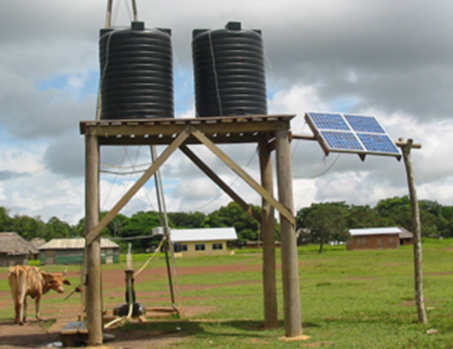
Two important concepts
Water per day
Total water requirements for the application
Pump water during daylight hours
Store water not electricity
Make water available when needed
Simple and efficient

Slide 3
Two important concepts
Water per day
Historically pumps have been specified based on the flow they deliver per minute or hour. For example 1000 litres per hour or 264 USG per hour or 4.2 gallons per minute
With solar pumping you are looking to maximise the water pumped while the sun shines. For this reason litres (or cubic metres or gallons) per day is the critical measurement
Always talk about customer requirements per day rather than per hour to avoid confusion
Store water not electricity
Relying on batteries to pump water overnight introduces cost and complexity to a solution
Batteries are heavy, expensive, difficult to transport and dispose of and have a limited (3 year typically) life
Storing water in an elevated tank is efficient and means water is always available

Slide 4
Initial Site Information
Borehole Site – Dadaab, Kenya
Borehole Depth – 60m
Borehole Yield – 3 m³/hr
Daily Water Requirement – 10 m³
Avg Daily Solar Irradiation – 6 kWh/m²
Ambient Temp – 30ºC

Slide 5
Average Daily Irradiation (EA)
kWhr/m³

Slide 6
Case 1: 10m3/day/No Tank
Using Compass Solar Pump Tool
PS600 HR-10 Selected
Avg Daily Output 10m³hr
Solar Power Required: 750Wp (3 Panels of 250W)
Detailed Design Report Attached

Slide 7
Water Produced/Consumed

Slide 8
New Site Information
Daily Water Requirement – 16 m³
Avg of 1 m3/hr is required up to 11pm at night.
All other factors remain constant.

Slide 9
Case 2: 16m³/day (Plus Tank)
Using Compass Solar Pump Tool
Use 10m³ storage tank for night consumption
PS600 HR-10 Selected
Avg Daily Output 16m³hr
Solar Power Required: 1,500Wp (6 Panels of 250W)
Detailed Design Report Attached
Additional CAPEX: 1 No 10m3 tank, 3 No Panels of 250W.
Additional O&M: None.

Slide 10
Water Produced/Consumed

Slide 11
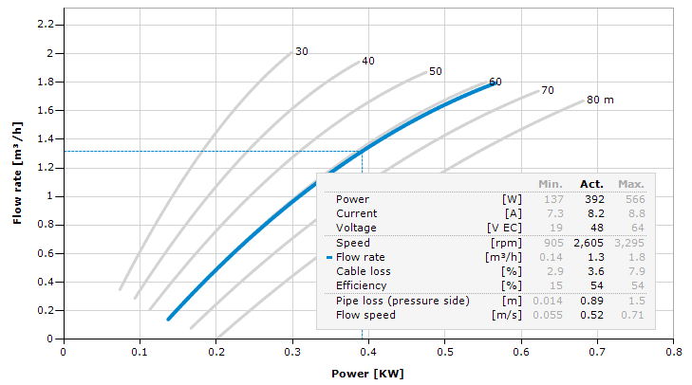
Case 3: 16m3/day (Plus batteries)
Using Compass Solar Pump Tool
PS600 HR-10 Selected
Daily Power Reqts:
At 48VDC Battery Voltage.
Power = 392 W, Flow = 1.3m3/hr
For 16m³/day, pump needs 16/1.3 = 12.3 operating hrs per day.
392 x 12.3 = 4,822 Wh per day.
4,822/48 = 100 Ah.
Battery Depth of discharge 50% -> Use 100Ah/050% = 200 Ah
Battery Array – Use 2 strings of 4 12 V, 100 AH batteries to achieve 48V, 200AH power.

Slide 12
Case 3: 16m3/day (Plus batteries)
Array Sizing:
Battery efficiency 85%
Wiring efficiency 97%
PV efficiency: 90% (cell temp/dirt)
PV battery mismatch (MPPT tracking) 100%
PV Charge controller efficiency: 95%
Total Efficiency factor
.85*.97*.9*1*.95 = 0.70
Solar Array Size = 4,822Wh/6kWh = 804 Wp Solar Array / 0.7 losses = 1,149 Wp
6 SOLAR PANELS OF 250 Wp
Additional CAPEX: 8 No 100Ah batteries, 30A Charge Controller, 3 No Panels of 250W.
Additional O&M: Battery Replacement every 3-5 years.

Slide 13
Water Produced/Consumed

Slide 14
Comparison
 | Case 1 | Case 2 | Case 3
Flow | 10m3/day | 16m3/day | 16m3/day
Pump | PS600 HR-10 | PS600 HR-10 | PS600 HR-10
# Panels | 3 x 250 Watts | 6 x 250 Watts | 6 x 250 Watts
Tank | 0 | 1 No 10,000 lit (Budget K 80,000) | 0
Batteries | 0 | 0 | 8 No 12 V, 100 AH (Budget K 180,000)
Other Accessories |  | Float Switch | Charge Controller (Budget 30,000)
Supply Period | 8:00 – 16:00 | 8:00 – 23:00 | 8:00 – 20:00
O&M | None | None | Batteries (3 - 5yrs)

Slide 15
THANK YOU!
Q&A

